Slide 1

Mental Health
Visualizing the Mental Health Standing of India
Project Advisor: Dr. Saumya Jetley
Team 4
Anshika Srivastava
Arjun Sethi
Atharva Sawant
Divita Jain

Slide 2

Problem Statement & Motivation
Mental Health plays an integral role in every individual’s life as it is responsible for their cognitive capabilities and psychological well-being. Mental Health requires care and perseverance; yet, individuals neglect their mental well-being and solely care for their physical health. And, if not treated, they might attempt a life-threatening action or proceed into a state of depression.
According to a 2017 study led by the Indian Council of Medical Research (ICMR),
1 in 7 individuals in India has experienced mental disorders in their lifetime.
Depression & Anxiety Disorders are the most common mental disorders impacting 45.7 million & 44.9 million people, respectively.
There is only 1 trained psychiatrist for every 100,000 people with a mental illness.

Slide 3



Objective
Goal 1:
To visualize the prevalence of mental health disorders at the state level, with reflectance on the most affected demographic group.
Goal 2:
To recognize the most prevalent mental disorder among diverse age groups and gender and find relative prevalence of each mental disorder.
Goal 3:
To observe the most noticeable mental disorder prevailing in each state to discontinue the future deterioration of the situation.

Slide 4


Dataset
Shortlisted 7 of the most significant Mental Disorders which are present in India
Dataset Sources:
Global Burdern of Disease Study (GBDs): Number of cases per 100,000 affected by the shortlisted mental disorders
StatisticsTimes: Population for each state of India.
Combined the data from all the sources and converted them into .csv for further computation over Jupyter Lab.

Slide 5
Results & Insights
To analyse the data,
We plotted the number of cases in a particular age group per 100,000 people on a heatmap and categorised them according to their age, gender and disorder.
Further, we also plotted the population of each state, categorised by age group and gender in order to find the total number of people suffering from that disorder.
Dividing the number of affected people in a particular state by the total population of this state gives a normalised value for all disorders in that state.
By plotting the number of cases and normalised values ​​for each condition in the form of histogram, we were able to derive the intensity of each disorder and their relative prevalence in each state. We did the comparative analysis of the two histograms.

Slide 6
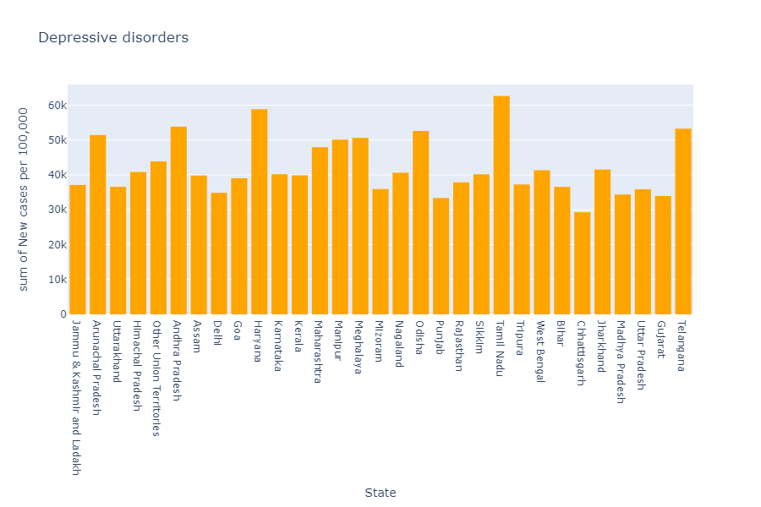
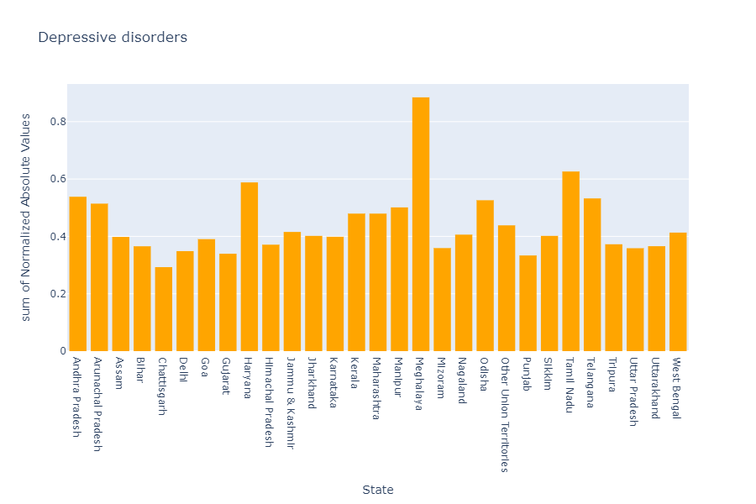
Fig. 1
Fig. 2
The graphs in Fig. 1 & Fig. 2 below reveal the number of cases of Depressive Disorder in each state and their normalised scores repectively.
From Fig. 1, we can infer that Tamil Nadu and Haryana have more cases of Depression, but Meghalaya has high normalised value in the same, this is because the normalised values ​​are population-dependent.
For the same number of people selected from the total population of Tamil Nadu and Meghalaya, there will be more people suffering from depression in Meghalaya than in Tamil Nadu.

Slide 7

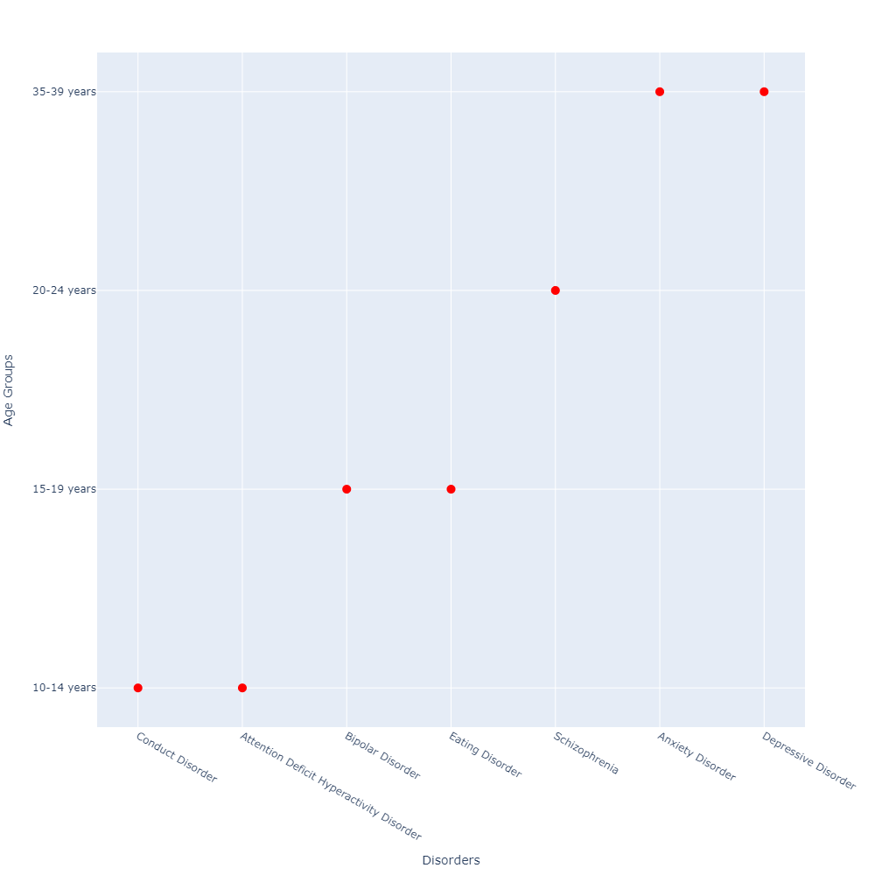
Further, we plotted graphs on the basis of age (Age-Wise Comparison) to compare the prevalence of each disorder within all age groups gender-wise.
After analysing these graphs, we found that every different disorder was affecting different age groups differently.
Schizophrenia was found most common in the age group of 20-24 years and rarely in the age group of 10-14 years whereas Conduct disorder and Attention Deficit/Hyperactivity Disorder was affecting 10-14 age years group the most.
All the states of India almost heeded the same tendency (represented in Fig. 3).
Fig. 3

Slide 8

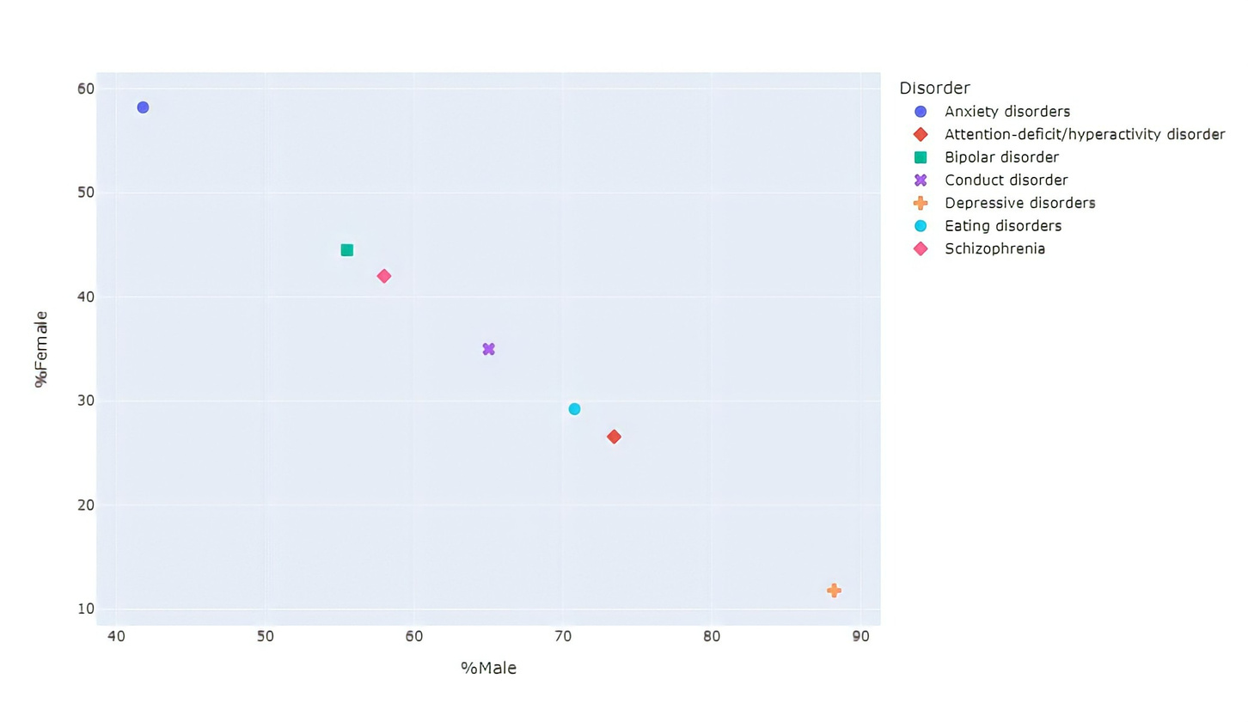
The number of cases per 100,000 for Depressive disorder in the case of females is higher than that of males, but when we calculate the percentage, we can see that the percentage of females suffering from Depressive disorder from the total population ​​ appears to be very low in comparision to males.
This is mainly due to the small female population. Similarly conclusions are drawn for other disorders as well.
Fig. 4
We plotted the scatter plot in Fig. 4 to present the percentage of men and women suffering from these mental disorders. We can see the relative prevalence of a disorder in the two genders.

Slide 9

Future Scope
Study can be further enhanced by:
Employing advanced techniques of data analysis and visualisation.
Creating a predictive model of the number of cases for each state in order to Prepare adequate resources for the same in the future.
Predict and analyse resource allocation
Thank you!

